Slide 2
Workshop data files
Data files can be download from GitHub:
https://github.com/Thimgan/GISVT2025
Default install location:
C:\Users\{Your_UserName}\GISVT2025

Slide 3




CONVERTING SPSS REGRESSION MODELS TO PYTHON REGRESSION MODELS USING JUPYTER NOTEBOOK
Brad Welborn
CTO, Thimgan & Associates
Brad@Thimgan.com
Zach Knepp
Data Scientist, Thimgan & Associates
Zach@Thimgan.com

Slide 4
Workshop Agenda
Differences between SPSS, Python and Jupyter Notebook
Installing the Python Anaconda platform
Understanding the Pandas statistical package
Importing CAMA data
Creating additive and multiplicative models with Python
Defining and using functions for modeling
Using graphics to visualize modeling results
Exporting predicted values
Automating the modeling process

Slide 5
SPSS
Statistical Package for the Social Sciences
Software package used for statistical analysis
Closed source software
Developed by IBM widely used in academia, business, and government
Provides range of statistical analysis tools
User-friendly interface

Slide 6
Python
High level interpreted programming language
One of the most popular programming languages in the world: easy to learn, practical for serious projects, third-party software.
Language of choice for data analysis and machine learning
Code can be organized into notebooks where individual cells can be executed and documented in the same place
File extension .py (Python script) or ipnyb (interactive Python notebook)
Large eco system of third-party libraries
No semicolons but uses indentation to determine scope of a line of code

Slide 7
Why Python?
The TIOBE index is revered for its methodical evaluation of programming language popularity based on various factors, including the number of skilled engineers and courses available.
https://www.tiobe.com/tiobe-index/
As of February 2024, Python comfortably holds the first position with 23.88%. This is a testament to its robust community support and the breadth of its application areas. Its syntax simplicity combined with an expansive library ecosystem makes it a favorite, especially among beginners and interdisciplinary professionals.
The TIOBE index essentially indicates how relevant a developer's programming language skills are to the current market demand, as it ranks programming languages based on their popularity by analyzing factors like the number of skilled engineers, available courses, and third-party vendors associated with each language, thus giving insight into which skills are most sought-after by employers.
R’s position at rank 15 on the TIOBE index is equally commendable. One year ago, it was at rank 21. While it might not have the same broad-based application as Python, its dominance in the statistical computing and graphics realm is unmatched. The consistent top-20 ranking indicates that industries, especially those heavily reliant on data interpretation (mostly, like pharmaceuticals, finance, and research) continue to value the precision and capabilities R offers.

Slide 8
Jupyter Notebook
Programming in the browser
Code, instructions, and output are displayed "in-line“
Can use Markdown for styling documentation
Useful for writing code that tells a story
Not used for programming applications

Slide 9
Anaconda
Anaconda Python is a free, open-source platform that allows you to write and execute code in the programming language Python.
Anaconda Python is the perfect platform for beginners who want to learn Python. It's easy to install, and you can get started quickly with the included Jupyter Notebook.
People like using Anaconda Python because it simplifies package deployment and management. It also comes with a large number of libraries/packages that you can use for your projects.

Slide 10
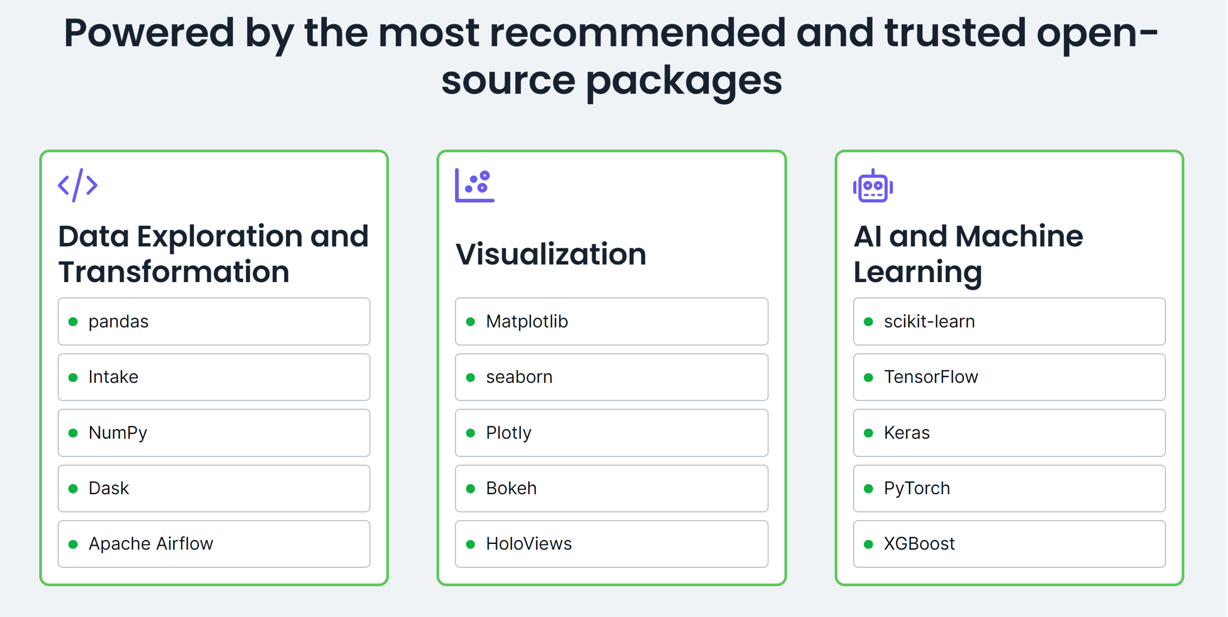
Anaconda Packages

Slide 11
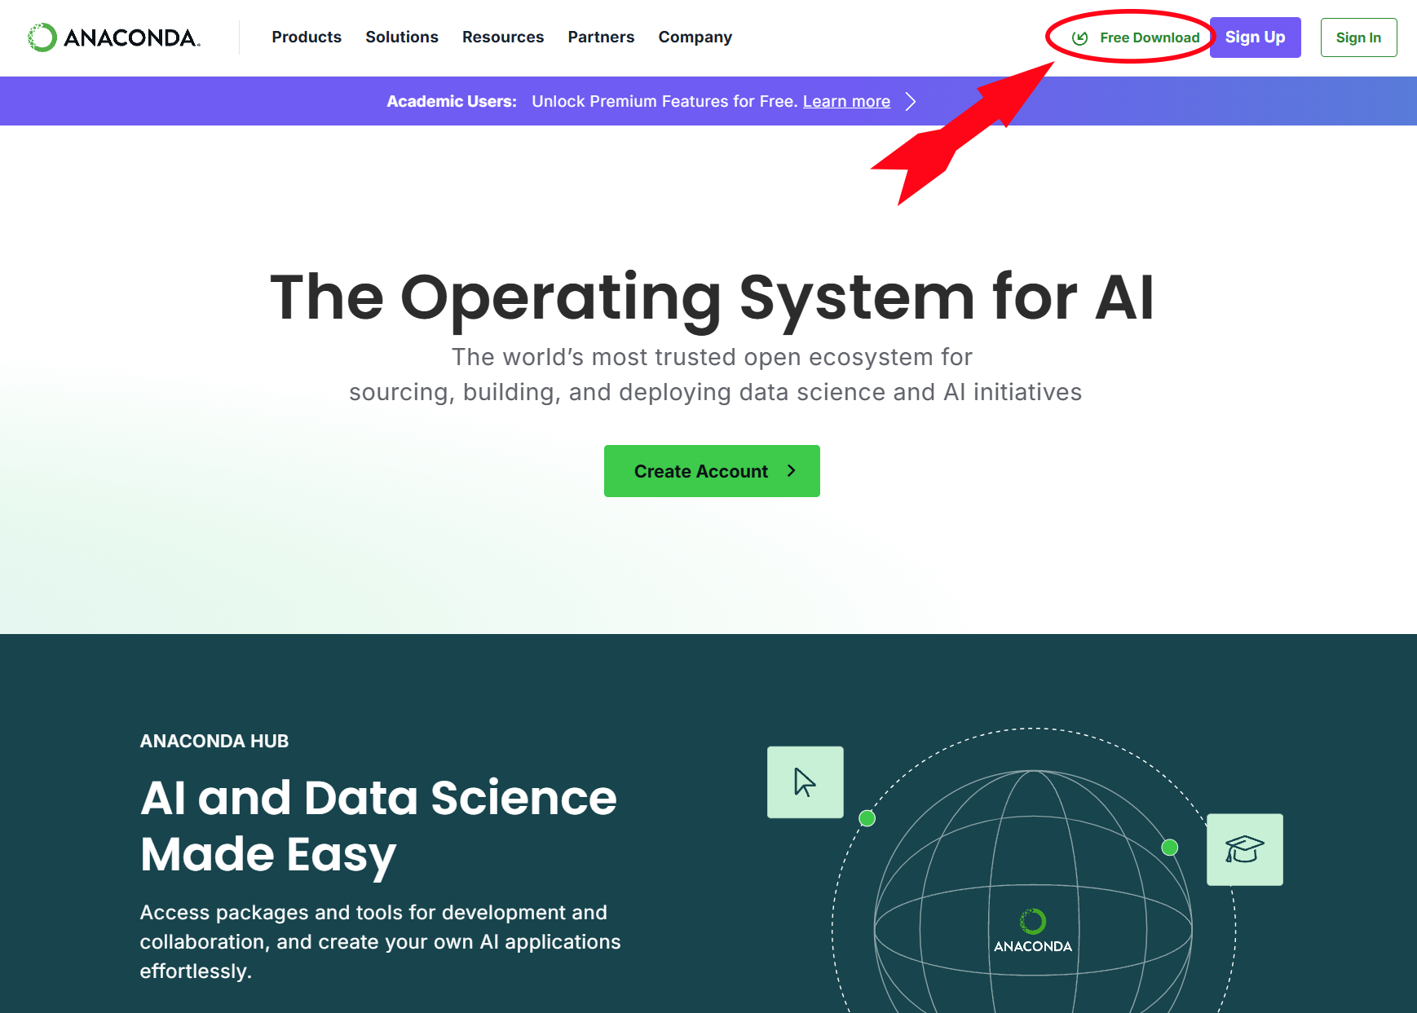
Anaconda Installation
https://www.anaconda.com

Slide 12
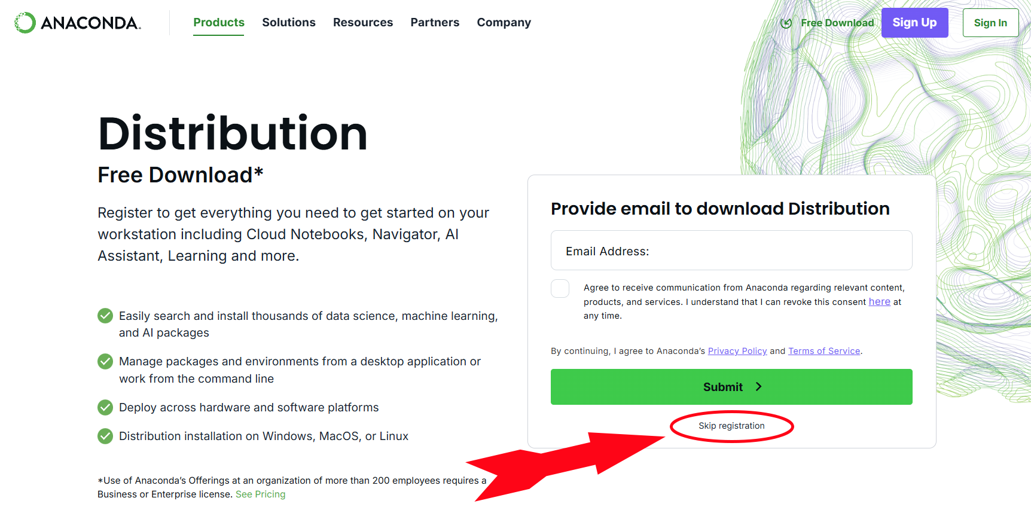
Registration

Slide 13
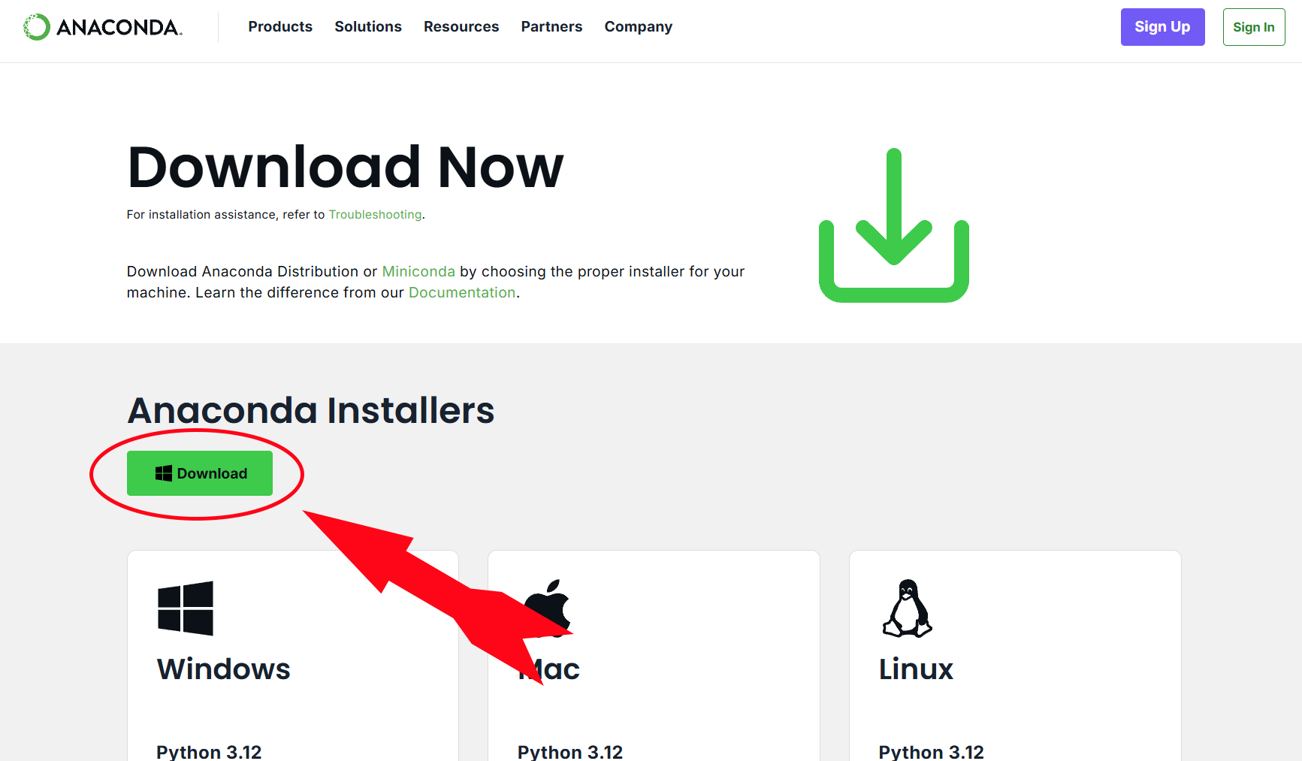
Anaconda Download Page

Slide 14

Continuing Education (CE) Credits
Recertification Credit forms for CE credits can be collected from the registration area on Thursday
Housekeeping
The conference proceedings will be available approximately 8 weeks after the conference
Please silence your electronic devices
Attendance at this conference counts toward GIS Professional (GISP) Certification and renewal

Slide 15

IAAO Annual Conference & Exhibition

Slide 16

Converting SPSS Regression Models to Python Regression Models Using Jupyter Notebook
Brad Welborn
Brad@Thimgan.com
Zach Knepp
Zach@Thimgan.com
Please take the Session Survey

